Slide 1

Jenkins CI/CD

Slide 2
What is Jenkins?
Jenkins is a self-contained, open source automation server that can be used to automate all sorts of tasks related to building, testing, and delivering or deploying software.

Slide 3
Install
Use the script in the learner guide to install Jenkins.
Please note:
If you are using the script then you will need to have sudo access on the machine you execute it on.
Once you have ran the script, you should be able to go to port 8080 on your machine and the Jenkins app should appear.

Slide 4
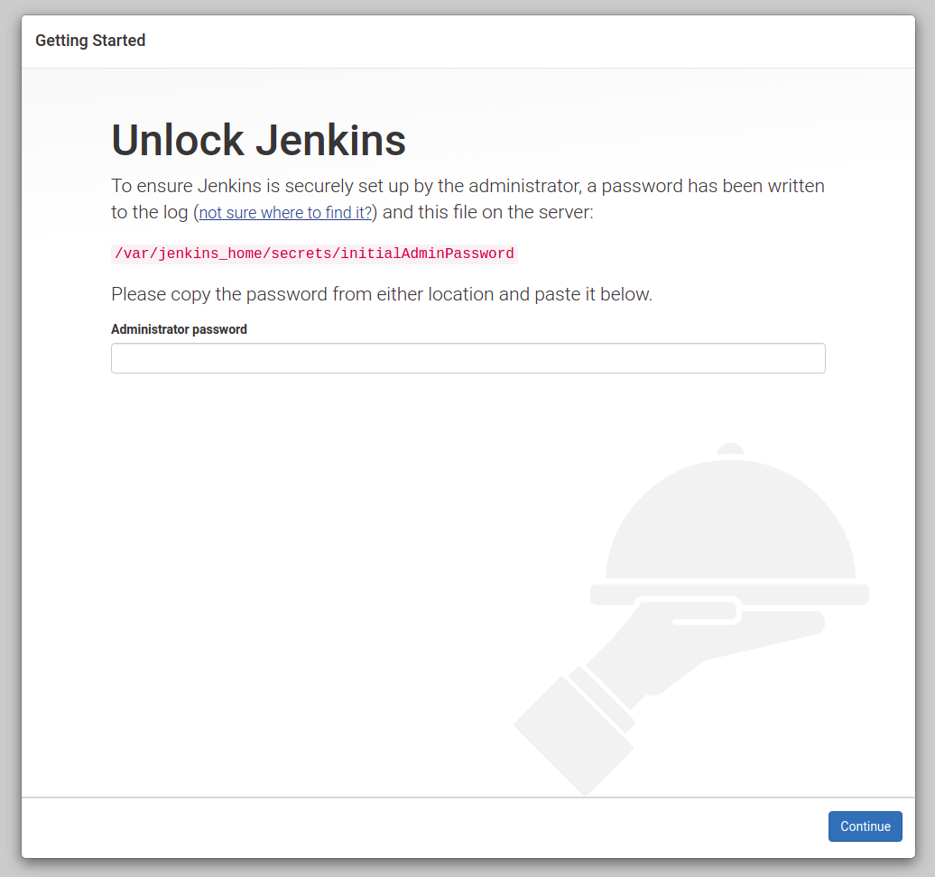
Install –
Step 1

Slide 5
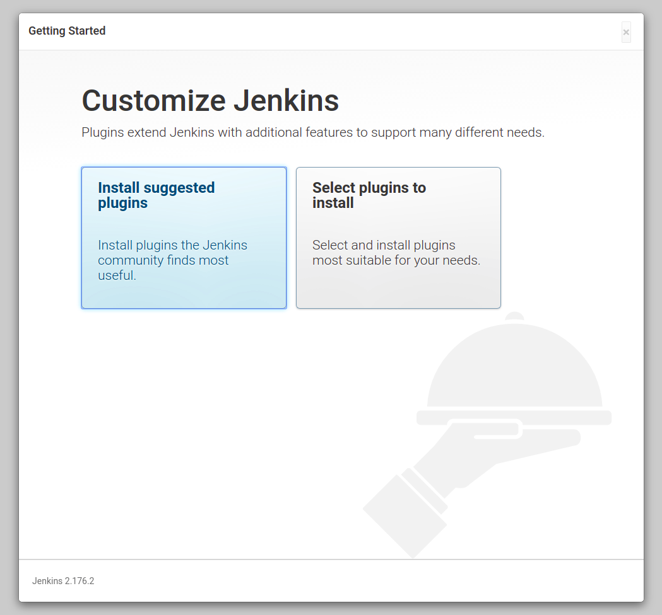
Install –
Step 2
Enter the initial admin password and select Install suggested plugins

Slide 6
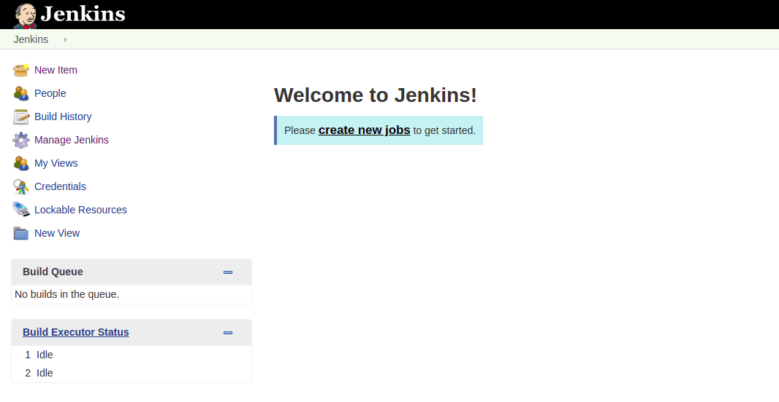
Install –
Step 3
Follow the next steps:
Create a user and then select Save and Finish
This should bring you to the Jenkins dashboard

